Slide 1
Activity Recognition -Multiclass Classification
Elaiyaraj .P

Slide 2
Approach
Problem Statement
Objective
Data Summary
Exploratory Data Analysis
Data Wrangling
Feature Selection
Model
Result
Recommendations

Slide 3
Problem Statement & Objective:
Problem Statement:
There are 15 participants who wore accelerator meter to collect data on various actions. The accelerator meter data contains x acceleration, y acceleration, z acceleration, and label. Your task is to build a model that can classify an action based on the input accelerator meter data (x acceleration, y acceleration, z acceleration).
Objective:
Build a model to classify an action, based on their accelerator meter input.

Slide 4
Data Summary
To classify the action, used “1926896” sample of 15 participants information with 4 important features.
In the Label column, we have 8 different actions, which would be considered as a dependent feature to classify the actions on models.
Around 91% of the data are developed by 4 important actions (Labels are 1,3,4 & 7) and we have to do OVER SAMPLING technique to overcome the imbalanced distribution. I have implemented “SMOTE” method for over sampling.
Action | Action - Description | Proportion
0 | Not Mentioned | 0.19%
1 | Working at Computer | 31.59%
2 | Standing Up, Walking and Going up\down stairs | 2.48%
3 | Standing | 11.25%
4 | Walking | 18.53%
5 | Going Up\Down Stairs | 2.67%
6 | Walking and Talking with Someone | 2.48%
7 | Talking while Standing | 30.80%

Slide 5
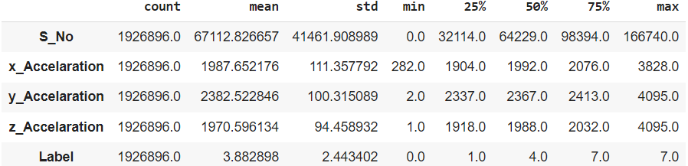
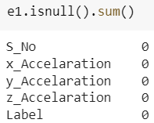
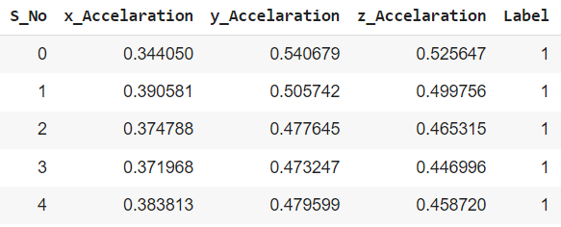
Exploratory Data Analysis, Data Wrangling & Split:
There are no missing values and outliers in the data to treat.
Data Scaling and Data Split:
Even though, the features (X, Y & Z accelerators) are in the same unit, I have implemented “MinMaxScaler” to scale the variable for modelling purpose to run the model fast and smooth. I have segregated the data into 70 – 30 subset for Training and Testing of the models.

Slide 6
Feature Selection, MODEL'S and Result
Feature Selection:
There are no redundant features or curse of dimensionality to do the feature selection.
Models & Result:
I have tested the data with multiple classification techniques to build the best model with high accuracy and finally chosen “K- Nearest Neighbor" (77.48% accuracy) algorithm, which suits the data comparatively better than other models.

Slide 7
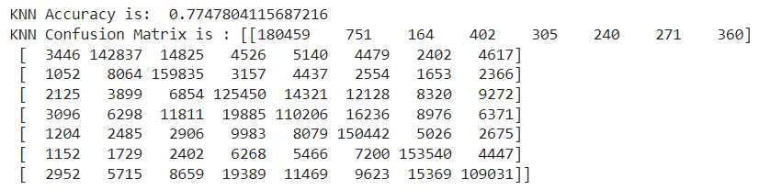
K – Nearest Neighbors & Recommendation:
K Nearest Neighbor (KNN) is a very simple, easy-to-understand, and versatile machine learning algorithm. KNN is a simple algorithm, based on the local minimum of the target function which is used to learn an unknown function of desired precision and accuracy. The algorithm also finds the neighborhood of an unknown input, its range or distance from it, and other parameters.
Recommendation:
1. If we get, few more features (Food, life style, etc..) on the accelerators, there is a chance of improvising the accuracy of the model.

Slide 8
THANK YOU

